Slide 1
Haemocytes and their Function

Slide 2
Haemocytes
The blood cells or haemocytes arise in the embryo from the median walls of the coelomic sacs and are thought to increase during post embryonic development partly by the division of existing haemocytes and partly through the activity of more or less discrete haematopoitic organs
The number of cells present in the circulating blood varies from 1000 per cubic mm to 100000 per cubic mm of blood in different species
Females tend to have high counts than males; endopterygote larvae have relatively more cells than their adults though reverse is true of exopterygote nymphs
Many different types of haemocytes have been described but a comprehensive classification is difficult because individual cells can have very different appearances under different conditions
The main types of haemocytes in insects are:

Slide 3
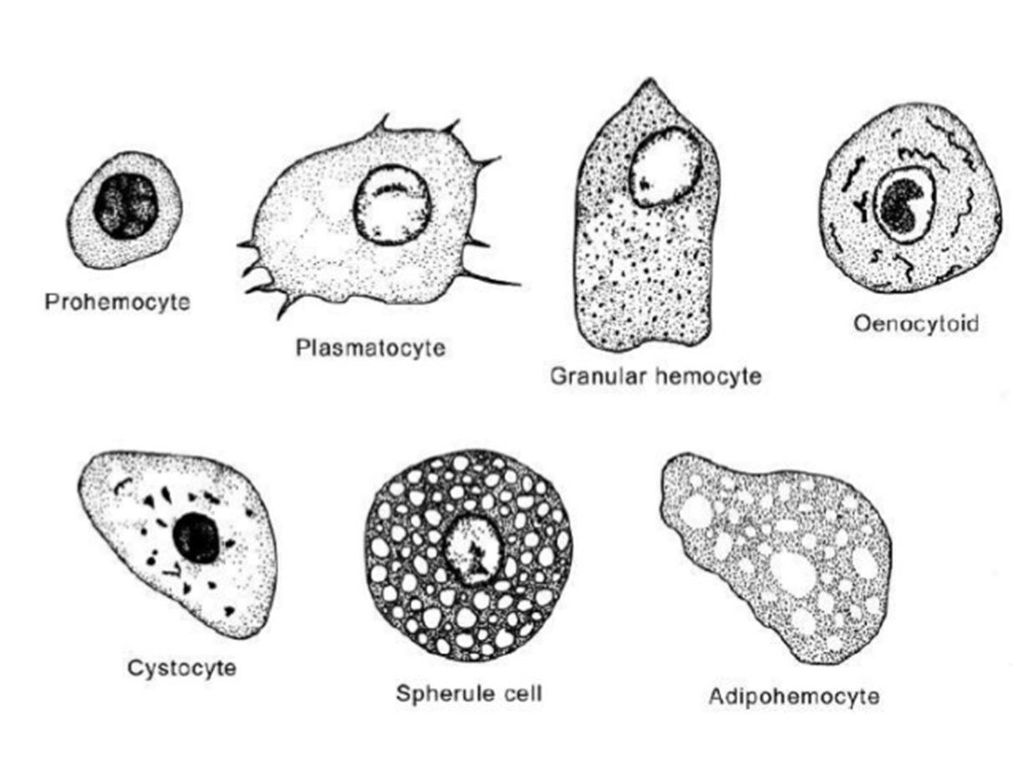

Slide 4
Prohemocytes:
Are characterized by a high nuclear: cytoplasmic ratio and a general lack of organelles involved in synthesis
They are rounded or oval cells, measuring 6-13μ in diameter
They rarely comprise more than 5% of the total hemocyte population
They are believed to be the stem cells that postembryonically give rise to other cell types
Plasmatocytes:
Are large, more ameboid, pleomorphic cells with a nucleus surrounded by large amount of cytoplasm
They contain moderate amounts of rough endoplasmic reticulum and Golgi complexes and may contain membrane-bound granules
They are amongst the most abundant hemocytes and usually account for more than 30% of the total hemocyte count
They are involved in phagocytosis and encapsulation of foreign organisms invading the hemocoel

Slide 5
Granulocytes
Are compact cells with a small nucleus, round or oval in shape, measuring about 10-17μ in diameter
They have a relatively high nucleus: cytoplasm ratio
They comprise a considerable proportion, usually more than 30% of the haemocyte population
They contain large amounts of endoplasmic reticulum; Golgi complexes are also abundant and the cells contain large numbers of membrane-bound organelles
Their cytoplasm is packed with granules and can form fine extensions which attach the cells to their substrate
They discharge their contents (degranulate) on the surfaces of intruding organisms as an early part of the defense response
Granulocytes are probably derived from plasmatocytes and are sometimes indistinguishable from them

Slide 6
Spherule cells:
Are oval or spindle shaped 8-16μ in diameter and usually full of large granules or spherules
Granules may occupy 90% of the cytoplasm that may obscure the appearance of small nucleus
Like granulocytes they exude fine attachment processes and are non motile
Their function is unknown
Oenocytoids:
Are relatively large ovoid cells, measuring about 19μ in diameter with a relatively small nucleus and few cytoplasmic granules
These cells exhibit little development of rough endoplasmic reticulum or Golgi complexes, but they have a complex array of microtubules and sometimes also crystalline inclusions

Slide 7
Adipohemocytes:
Characteristically contain lipid droplets
The nucleus: cytoplasm ratio is low
They contain well developed endoplasmic reticulum and Golgi complexes
Cystocytes:
Are round in shape, measuring about 9-14 μ in diameter with a relatively large nucleus
They are probably granulocytes in which the synthesis of granular content is complete

Slide 8
Functions of Hemolymph
Provides/acts as transport system for nutrients, hormones and metabolic wastes
Contains elements of immune system, provides defense mechanism against foreign organisms that enter the body
Play important role in wound healing
Play role in metabolism of specific compounds

Slide 9
Thank U

