Slide 1
Biochemistry of Haemolymph

Slide 2
Haemolymph
The blood, or hemolymph, circulates round the body, bathing the tissues directly
It consists of a fluid plasma in which blood cells, hemocytes, are suspended
The plasma, because of its function of maintaining the tissues throughout the body, contains many chemicals
Plasma contain 85% water, is usually slightly acidic and includes inorganic ions, proteins, amino acids, fats, sugars organic acids and other substances in variable amounts
The pH of insect hemolymph is usually between 6.4 and 6.8, although slightly alkaline values have been recorded in a dragonfly larva and in the larva of the midge, Chironomus

Slide 3
Hemolymph volume
It is expressed as a percentage of the total body weight of the insect, varies with insect species and physiological state significantly, eg:
Tenebrionid beetle, Onymachus, blood constitutes about 11% of the total body mass
In mid-stadium larvae of Locusta, it is about 18%, while in adults it is about 12%
In cockroaches it is about 17%
In caterpillars 35–40%
Hemolymph water comprises 20–25% of the total body water in adult insects, but in caterpillars, the figure is close to 50%; this reflects the important hydrostatic function of the hemolymph in these larval forms; this role is further evidenced in other insects at the time of the molt where an increase in hemolymph volume occurs before each ecdysis. Before each molt of the desert locust, Schistocerca, the relative blood volume almost doubles, and is then reduced again after the molt
In Periplaneta, the pre-molt increase in volume is associated with an increase in activity of an antidiuretic hormone and the post-ecdysial fall in volume is produced by a transient rise in the hemolymph titer of diuretic hormone

Slide 4
Constituents of the plasma
Inorganic constituents
Chloride is the most abundant inorganic anion in insect blood
It is present in high concentrations in Apterygota and hemimetabolous insects, but is characteristically low in holometabolous insects, usually amounting to less than 10% of the total osmolar concentration
Other inorganic anions present are carbonates and phosphates
The most abundant cation is usually sodium although the amount varies with the insect’s phylogeny and its diet
Most phytophagous insects have lower concentrations of sodium than insects with other feeding habits; potassium and magnesium levels tend to be higher in phytophagous groups reflecting the levels of these elements in plant tissues

Slide 5
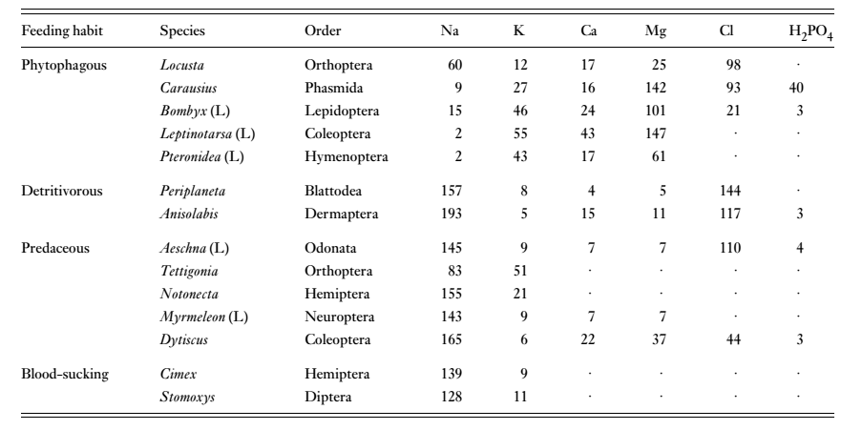
Major inorganic ions in the hemolymph of different insects (concentrations in mequiv./lit. or mmol/lit)

Slide 6
Amino Acids
Insect blood plasma is characterized by very high levels of free amino acids; the total concentration in plasma is usually more than 6 mg per ml in endopterygotes, but less than this in exopterygotes
Most of the protein amino acids are present, but their concentrations vary greatly from insect to insect; in endopterygotes glutamine and proline are present in high concentrations relative to most other amino acids; Glutamate (glutamic acid), on the other hand, is only present in very small quantities
The concentrations of amino acids may change at different stages of the life cycle. Tyrosine, for instance, commonly accumulates before each molt and then decreases sharply as it is used in tanning and melanization of the new cuticle
Glycine is one of the major amino acids in the blood of Bombyx mori towards the end of feeding stage but it decline after spinning as it is the major constituent of silk

Slide 7
Proteins
Insect hemolymph plasma contains many different proteins with a variety of functions
The total quantity of protein in the blood varies in the course of development, but peak concentrations in the late larval stages
These proteins are usually classified by function and they are grouped as storage proteins, lipid transport proteins, vitellogenins, enzymes, proteinase inhibitors, chromoproteins, and a range of different proteins that are probably involved in the immune responses of insects

Slide 8
Other Organic Constituents
Products of nitrogen metabolism like uric acid, ammonia, urea, and allantoin
Various peptides and biogenic amines, acting as neurohormones or neuromodulators are always present
Hormones, such as ecdysone and juvenile hormone, occur periodically
Carbohydrates like Trehalose, a disaccharide is the most characteristic sugar found in insect hemolymph; Glucose is also often present, usually in much lower concentrations; other carbohydrates are such as hexosamines involved in chitin synthesis and, sometimes, the sugar alcohol, inositol is also present
Glycerol or Mannitol is probably always present, and, in insects able to tolerate freezing, the concentration may be very high
The concentration of lipids in the hemolymph generally varies between about 1 and 5 mg per ml, but values approaching 15 mg per ml are achieved in insects, such as Locusta and Manduca, that use lipids as fuels for flight.
Most of the lipid is in the form of diacylglycerols; these components are normally carried by lipophorins
Organic acids like citrate, α-ketoglutarate, succinate and malate are also present

Slide 9
Thank U

